Slide 1

Contents
How to log onto QualDash
QualDash home screen (Qualcards)
How to show counts and percentages
How to change the layout of the qualcards
How to expand the qualcards to see more data
Expanded Qualcards
How to interact with the measures
How to add and remove measures
Exporting graphs and data
How to export graphs and charts
How to export raw data
Data quality pane
Tips on interpreting data
Customisation/reporting problems

Slide 2

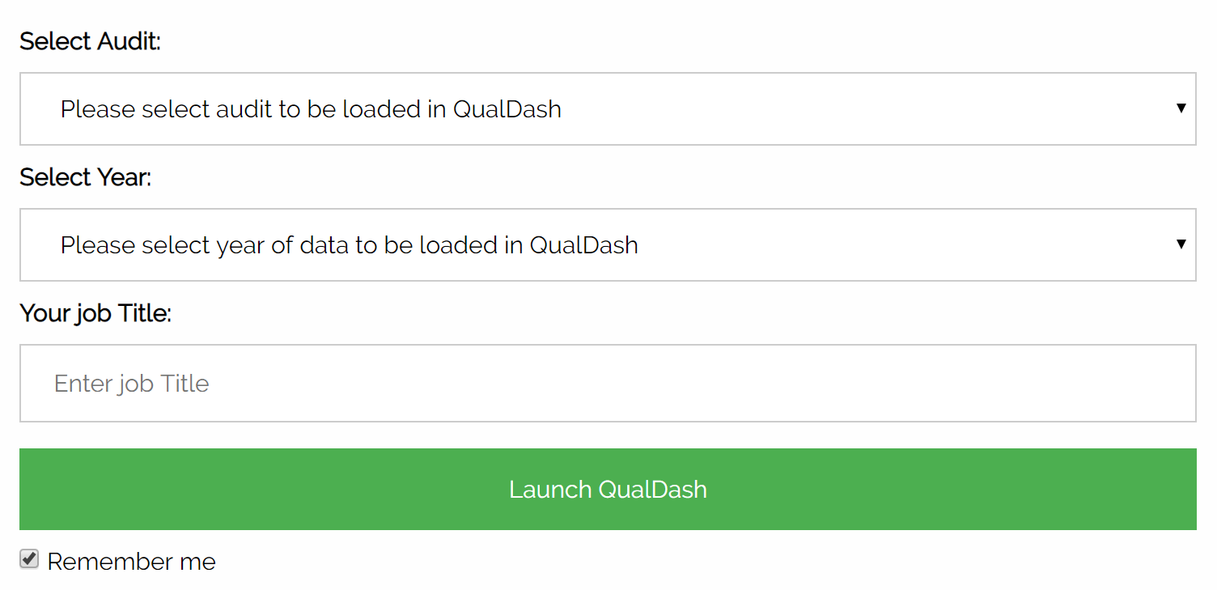
1. How to log onto QualDash
QualDash can be accessed via Google chrome. If you don’t have Chrome, please ask your IT department to install it.
If you have not been provided with a URL please contact the QualDash team (contact details at the end of this document).
When the QualDash web page opens, click on the green button to ‘get started’.
You will be taken to this screen
Using the drop down list please enter
the audit you want to view - the choices are PICANet or MINAP only.
the year of data you want to view
your job title e.g. doctor, nurse, audit clerk
click ‘Launch QualDash’ to take you to the dashboard home screen.
NB: all data displayed on the dashboard will be from the year you enter at log in.

Slide 3
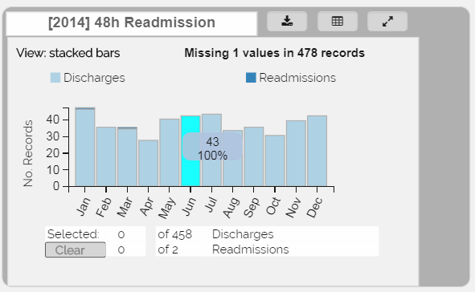
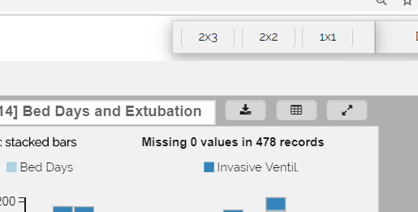
2. The QualDash home page
QualDash displays ‘qualcards’ that visualise audit data for different metrics. Qualcards can be thought of as a deck of cards spread out on the dashboard screen. They can be dragged around and rearranged, much like physical cards on a table surface. Each qualcard is used to answer key questions about service performance. For example, in the example below the qualcard addresses the questions: (1) how many discharges were there in a given month? and (2) how many of these discharges were readmitted within 48 hours? (See section 5 for a full list of qualcard descriptions).
a) To display the number/percentage in each bar, hover the mouse over the month you wish to investigate.
b) The layout of the qualcards can be changed by:
clicking the 3x2, 2x3 and 1x1 buttons in the top right hand corner of the home screen.
clicking the mouse in the dark grey area of the qualcard and dragging the card into a different position.
c) To expand the qualcards to see more data you can:
click the 1x1 layout to expand all the qualcards.
Click the arrows button at the top of the qualcard.
Double click in the grey area of the qualcard.
Please note that there’s no meaningful link between colours on different charts in the various qualcards – e.g. red on one chart doesn’t imply a meaningful connection with a red bar on another chart.

Slide 4
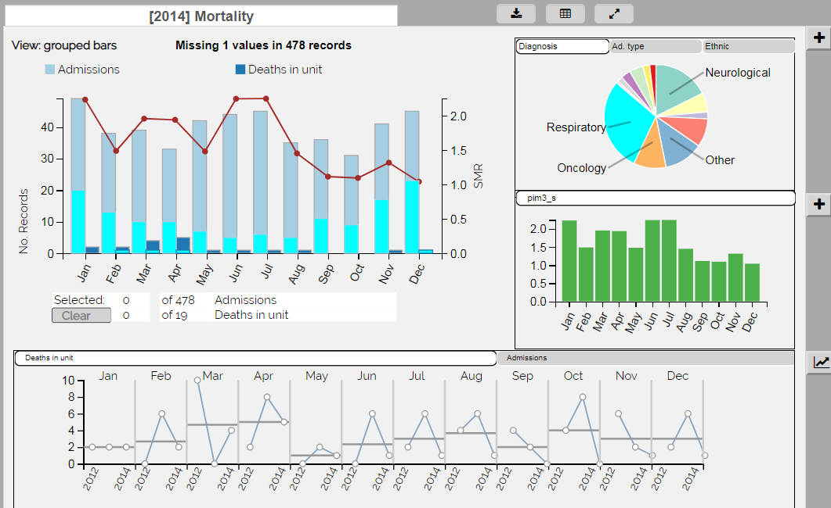
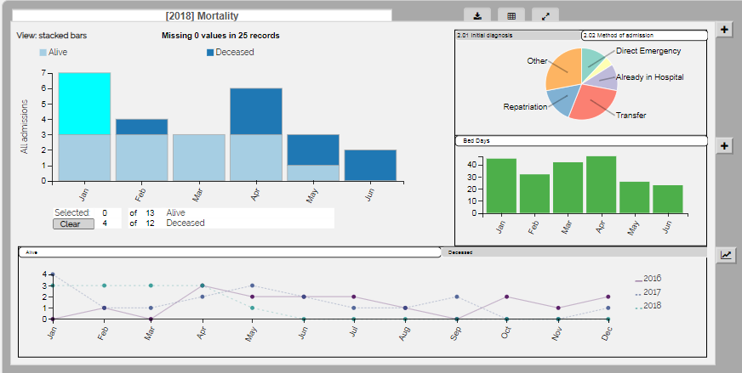
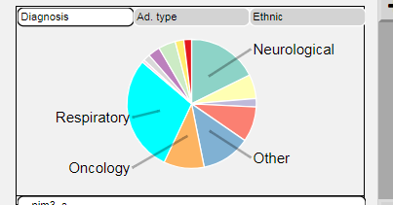
3. Expanded QualCards:
a) Expanded qualcards display more measures in sub-views that can be used to answer further questions relating to the card’s main metric. The sub-views include a categories sub-view (A), a quantities sub-view (B) and a history sub-view (C).
The pie chart, shown in (A) interacts with the main bar chart; hovering the mouse over a segment of the pie chart will highlight how this measure is distributed across the months of the year in the main bar chart. In the example below, the highlighted pie chart segment shows how many admission and deaths had a respiratory diagnosis.
A
B
C
The history sub-view (C) provides historic context to the measures shown in the main metric view. Each measure from the main view is displayed on a separate tab in this view for an extended time frame.
To explore the relationship between specific month(s) in the main bar chart and the pie chart, select the month(s) you wish to explore by highlighting the bar with a mouse click.
When specific months are selected, the pie chart will show you the data that relate to those months only.
In the sub-views, you can change which measure is displayed by clicking on the appropriate tab at the top of the box

Slide 5
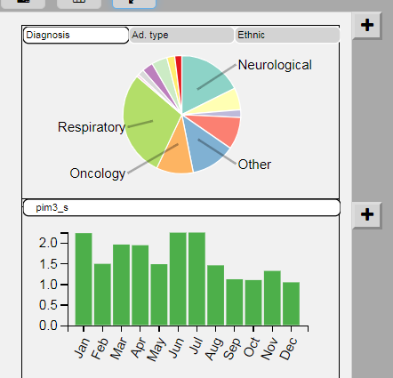
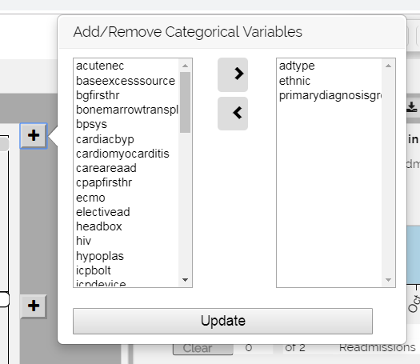
b) To add or remove measures to the pie chart or bar chart sub-view simply click on the ‘plus’ button in the top right hand corner of the sub-views.
The plus button will open a popover window.
In this window, the box on the right shows the measures currently displayed. The box on the left has all other audit measures listed in alphabetical order.
To add a measure, scroll through the list using the scroll bar and select the variable of your choice.
Move the measure into the right-hand box by clicking the right-facing arrow between the boxes.
Press update and the measure will appear as a new tab at the top of the sub view.
To remove a variable, follow the same process but move measures from the right to the left box.
If you don’t press the update button your changes will not be saved.
NB: The bar and pie sub-views currently support between one and five measures at a time. Your changes won’t take effect if you select too many or too few measures and QualDash will issue an error message asking you to add the appropriate number of measures.

Slide 6
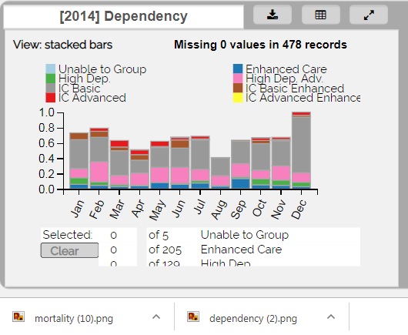
4. How to export graphs and data
To export the bar chart(s) in the qualcards on the home screen, click on the export button located at the top of the qualcard.
The bar chart will be automatically exported into a PNG file at the bottom of the dashboard, which you can save, copy and paste or drag and drop into reports, e.g. in Microsoft PowerPoint/Word etc.
To export the charts/graphs in the expanded views, follow the same process when the qualcard is expanded.
Please note that the PNG export may look distorted when viewed on Windows Photo Viewer. However, when exported to Powerpoint, it is displayed correctly.
This functionality is undergoing improvement. If you have any comments / suggestions about it, please contact the QualDash team (contact details at the end of this document).

Slide 7
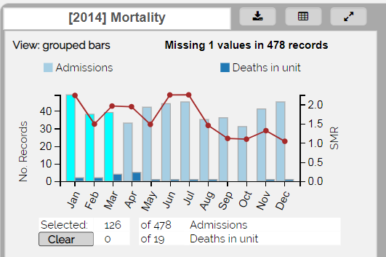
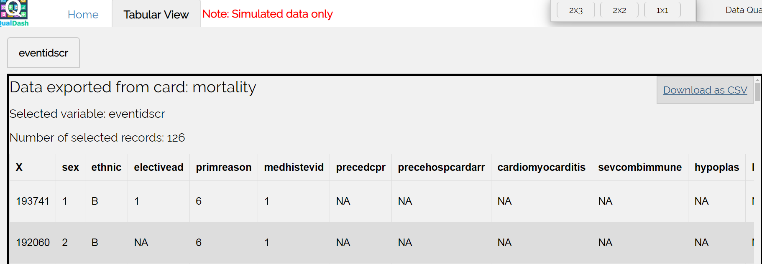
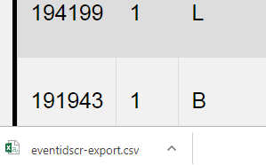
b) To export raw data into the tabular view, select the months of data you wish to export by highlighting them with the mouse, then click on the matrix button at the top of the qualcard.
The data will automatically be exported into a spreadsheet in the tabular view of the dashboard.
You can export the raw data in the tabular view into a CSV file, which can be opened as a spreadsheet in Excel, by clicking on the ‘download to CSV’ button in the top left of the spreadsheet.
The data will be automatically exported into a CSV file that you can access at the bottom of the dashboard screen.

Slide 8
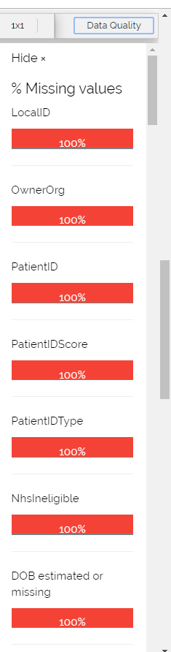
Data quality pane
The “Data Quality” button is located at the top right corner of the main dashboard screen, next to the layout buttons.
Press the button to reveal a side pane that shows the quality of the data on display. Specifically, the quality pane assesses only variables that are visualised in any of the qualcards, which have missing values in the dataset.
If a variable does not appear in the quality pane, it means that either (a) the variable is not included in any of the qualcards when the dashboard is loaded, or (b) the variable is included in one (or more) of the qualcards but does not have any missing values.
For variables shown on the quality pane, a horizontal bar shows the completeness of each one of the displayed variables. If a variable has values present in more than 75% of the records, its bar is shown in green. If this percentage drops below 75%, the bar is shown in amber and if the percentage drops below 25%, the bar is red.
Variables are listed in the pane in order of incompleteness, with the most incomplete variables listed first.
To draw meaningful conclusions from the data, it’s important that data are accurate and complete, so if there are lots of incomplete values and if the data quality bar is amber or red, you may to need to review data collection and validation processes before interpreting the data or basing decisions on them.

Slide 9
6. Tips on interpreting data
You don’t need to be a statistician to use QualDash effectively, but it’s important when using the dashboard - as with all data - to avoid drawing unfounded or inaccurate conclusions. Here are some simple tips to help you in your work:
Be careful about making general claims about small numbers or samples of patients or about unsustained or sudden changes in the data. Small samples may not be representative of your overall patient population, and sudden data changes may be no more than one-off anomalies, and may not represent shifts or trends. If you do identify such changes, review the data in depth to find out why they took place, and, if necessary, take measures to improve practice.
It’s important not to mistake correlation – a meaningful connection between two or more data points – or coincidence with causation. In other words, just because one thing happens before or at a similar time as another, it doesn’t mean the first caused the other.
Try not to take a particular stance when analysing data to avoid, as far as possible, being influenced too much by your own preconceptions. Some ways to do this include making sure conclusions are based on representative samples of patients, discussing conclusions with other colleagues to gather different views, and not drawing snap conclusions before exploring the data thoroughly.
If you’d like more advice on how to use data from national clinical audits effectively for quality improvement, there’s some helpful guidance on the website of the National Emergency Laparotomy Audit, at https://www.nela.org.uk/ This guidance suggests that improvement happens when:
Data are accurate and timely
You feed back results to the whole team regularly
You act together to make changes
You review the data to check for sustained improvement

Slide 10
History sub-view: same as main view with a historical context.
Possible tasks:
Was the number of patients receiving enhanced care in September this year higher than in September last year?
Card 5: Data Quality
This card is under re-construction and updated information will be supplied as soon as possible.
8. Customisation/reporting problems
If you would like to add new or adapt existing qualcards or report any problems with QualDash, please contact :
Natasha Alvarado| n.alvarado@leeds.ac.uk
Lynn McVey| l.mcvey@leeds.ac.uk

